Slide 1


APPLICATION
DETAILS
OF
GDS (POST-MAN)

Slide 2
Introduction
GDS stands for Gramena Dak Sevak. It is a central job notification for post-man service which consist of jobs like BPM, ABPM, Dak Sevak. All over the India the application is released. It has portal GDS for apply. This provides service to deliver the envelops and letters for the customers.

Slide 3
ER DIAGRAM OF GDS
User name
Mother name
Mobile no
User id
Email id
password
Registration id
city
state
view
Login detail
Registration detail
Registration id
Verification address
Status
Name
view
Father name
Date of applied
Registration id
Payment id
Verification date
view
view
Application details
Payment detail
Preferred state
Applicant name
Paid

Slide 4
Components present in GDS application

Slide 5
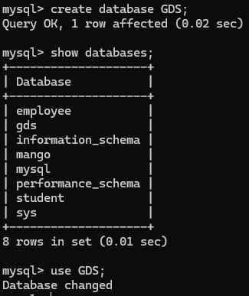
Database
Database is used to store the table data securely and provides the organised format for access, retrieve data, and managing data.
Syntax: create database GDS;

Slide 6
Structure of tables in
Database

Slide 7
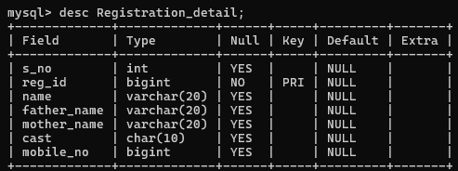
Registration details
Registration detail represents the details of applicant.
Syntax: create table registration_detail( s_no int, reg_id bigint unique not null, name varchar(20), father_name varchar(20), mother_name varchar(20), cast char(10), mobile_no bigint);

Slide 8
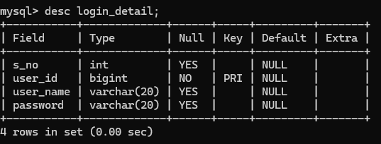
Login detail
Syntax: create table login_detail (s_no int, user_id bigint not null unique, user_name varchar(20), password varchar(20));

Slide 9
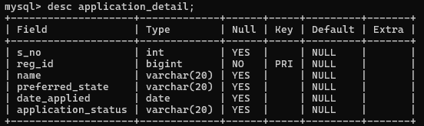
Application details
Syntax; create table status (s_no int, registration_id bigint not null unique, applicant_name varchar(20),date of applied date, preferred state varchar(20), application_status varchar(20));

Slide 10
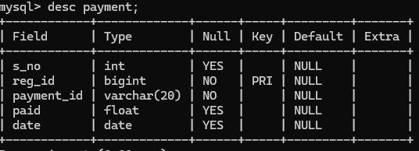
Payment status
Consist payment details.
Syntax: create table payment ( s_no int, reg_no bigint not null unique, payment_id varchar(20) not null, paid float, date date,;

Slide 11
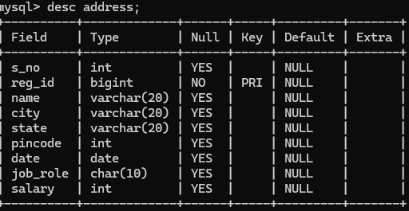
Verification address
Syntax: create table address (s_no int, reg_id int not null unique, name varchar(20), city varchar(20), state varchar(20), pin-code int, date date, job_role char(20), salary int);

Slide 12
Content of tables

Slide 13
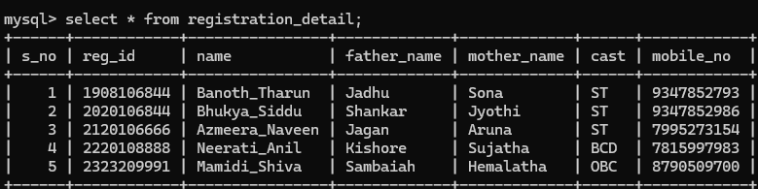
Registration details

Slide 14
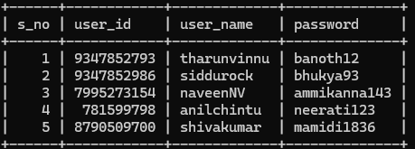
Login details

Slide 15
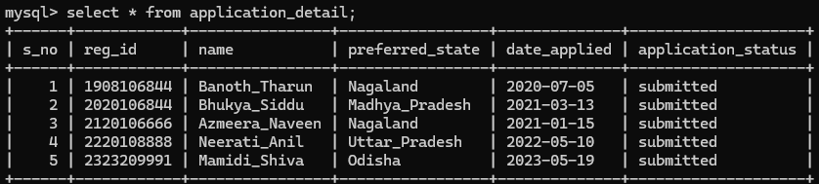
Application details

Slide 16
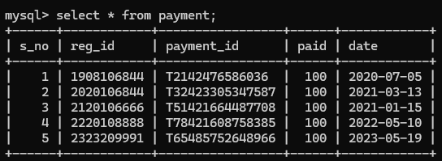
Payment details

Slide 17
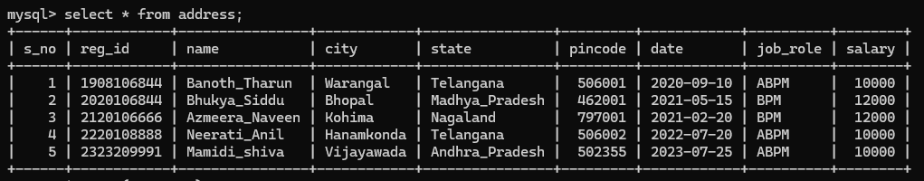
Verification address

Slide 18
Operations

Slide 19
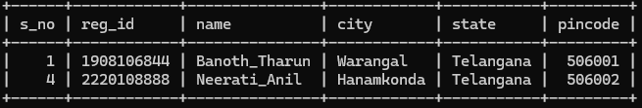
Query to display all data from address using “where clause”
Syntax: select * from address where state=“Telangana”;

Slide 20
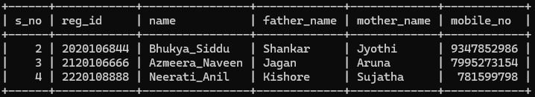
Query to display all the record in a range by using “between”
Syntax: select * from registration_detail where s_no between 2 and 4;

Slide 21
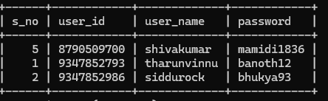
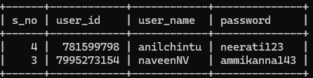
Query to display record from login details name “like %r% and not like %r%”
syntax: select * from login_detail where user_name like “%r%”;
syntax: select * from login_detail where user_name not like “%r%”;

Slide 22
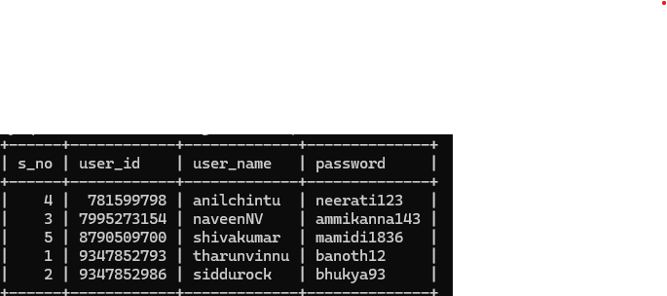
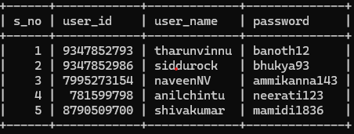
Order by clause
Before order by clause
After order by clause

Slide 23
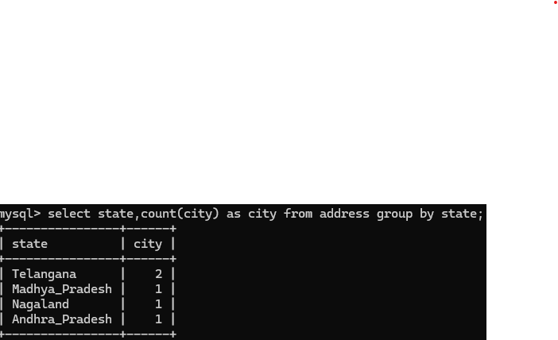
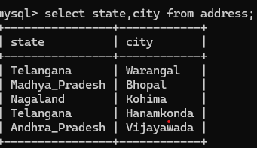
Group by clause
Before group by clause
After group by clause

Slide 24
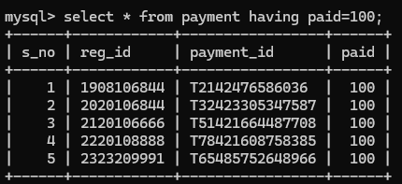
Having clause it is used to display the records which are in have condition.

Slide 25
Built-in functions

Slide 26
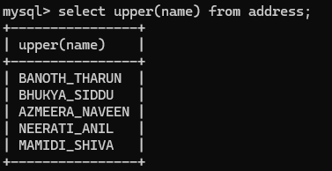
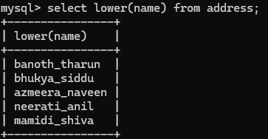
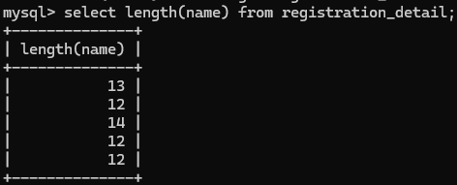
String functions using upper, lower, length.

Slide 27
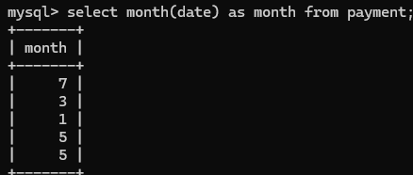
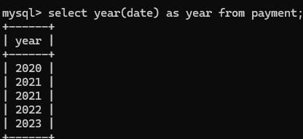
Date()function

Slide 28
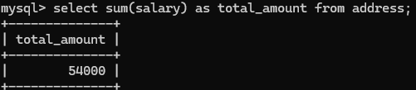
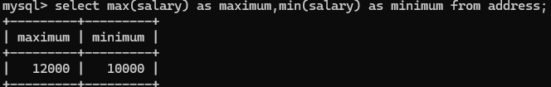
AGGREGATE() FUNCTION

Slide 29
Sub-queries:
A subquery is a SELECT statement which is used in another SELECT statement.
Subqueries are very useful when you need to select rows from a table with a condition that depends on the data of the table itself
The subquery can also be referred as nested SELECT, sub SELECT or inner SELECT.
In general, the subquery executes first and its output is used in the main query or outer query.

Slide 30
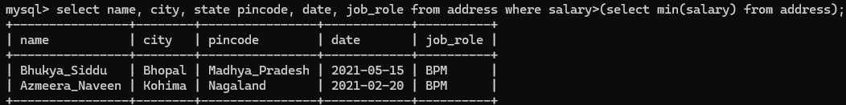
Retrieved the rows which are selected in main query by using of sub-query

Slide 31
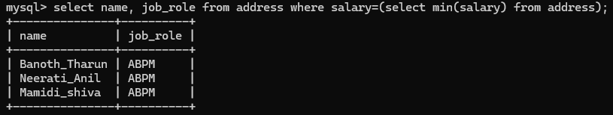
Sub-query helped me to find the job-role of the candidates based on salary.

Slide 32
JOINS:
A SQL Join statement is used to combine data or rows from two or more tables based on a common field between them.

Slide 33
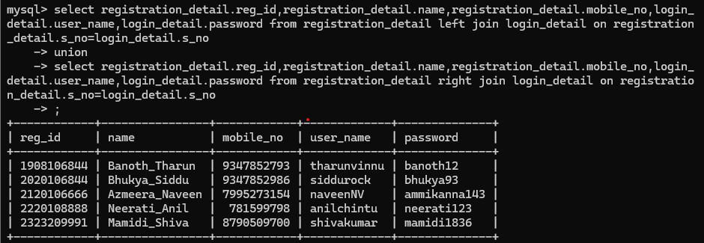

Slide 34
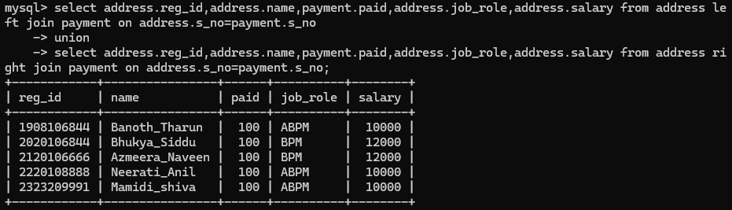

Slide 35
Views:
Views in SQL are kind of virtual tables.
A view also has rows and columns as they are in a real table in the database.
We can create a view by selecting fields from one or more tables present in the database.
A View can either have all the rows of a table or specific rows based on certain condition.
Syntax: create view view_name as (query);

Slide 36
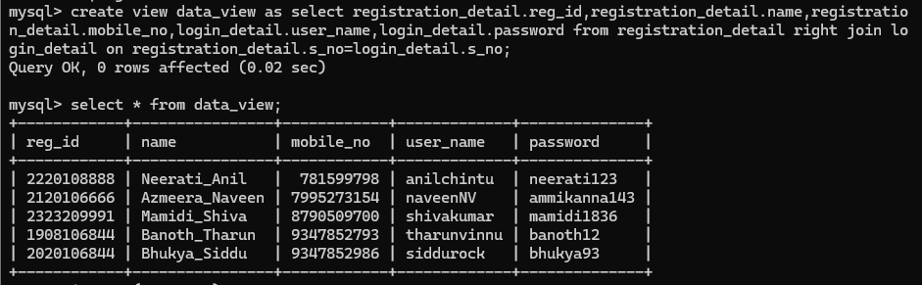

Slide 37
Scenario Based Questions

Slide 38
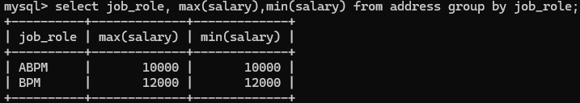
query to display which job role has least and highest salary

Slide 39
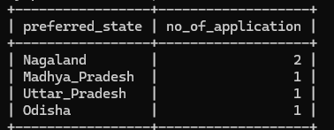
Query to display the number of applications in the state.

Slide 40
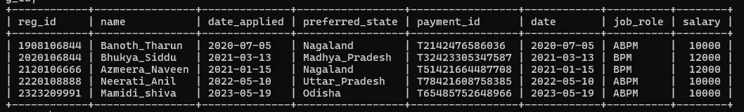
Candidate wise details
select address.reg_id,address.name,application_detail.date_applied,application_detail.preferred_state,payment.payment_id,payment.date,address.job_role,address.salary from address join application_detail on address.reg_id=application_detail.reg_id join payment on application_detail.reg_id=payment.re
g_id;

Slide 41
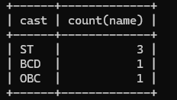
Query to find the cast wise count of applicant
Syntax: select cast,count(name) from registration_detail group by cast;

Slide 42
THANK YOU

